Slide 1
Fundaments of Electrical and Electronics (FEE)

Slide 2
Provisional Syllabus
We may add more topics in the provisional syllabus.
Component | Unit | Topics
Component 1 | Unit 1 | Circuit elements, KCL, KVL, Network Theorems, Transient and Steady-State Analysis
 | Unit 2 | Two-Port Networks, Transformers (Mutual Coupling, Impedance Transfer)
Component 2 | Unit 3 | Semiconductor, Junction Diode, Zener Diode, Simple Circuits
 | Unit 4 | Introduction to Logic Circuits, Boolean Algebra, Simple gates, Boolean Theorems

Slide 3
Electrical Circuit
Interconnection of the electrical elements.
For an example: a battery connected with wires.
Analysis of circuit:
To understand the response for a given input.
To understand the interaction of various elements inside a circuit.
Source
Load

Slide 4
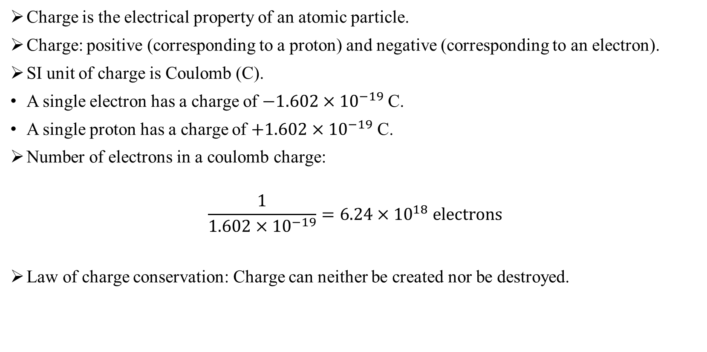
Charge (Q or q or q(t))
Charge is the electrical property of an atomic particle.
Charge: positive (corresponding to a proton) and negative (corresponding to an electron).
SI unit of charge is Coulomb (C).
A single electron has a charge of $−1.602×{10}^{−19}$ C.
A single proton has a charge of $+1.602×{10}^{−19}$ C.
Number of electrons in a coulomb charge:
$$\frac{1}{1.602×{10}^{−19}}=6.24×{10}^{18} electrons$$
Law of charge conservation: Charge can neither be created nor be destroyed.

Slide 5
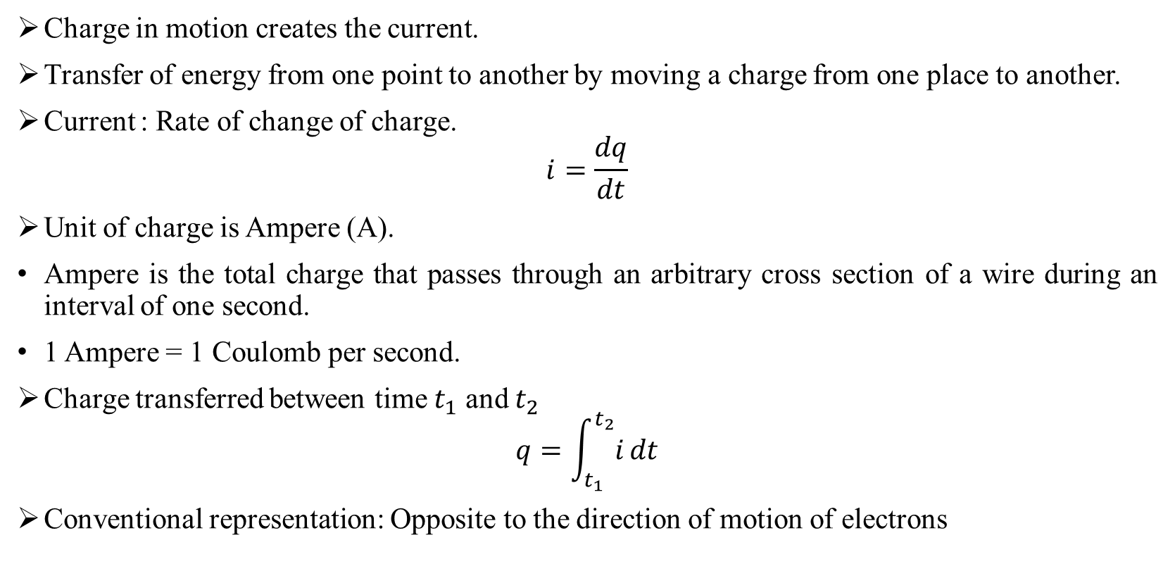
Current
Charge in motion creates the current.
Transfer of energy from one point to another by moving a charge from one place to another.
Current : Rate of change of charge.
$$i=\frac{dq}{dt}$$
Unit of charge is Ampere (A).
Ampere is the total charge that passes through an arbitrary cross section of a wire during an interval of one second.
1 Ampere = 1 Coulomb per second.
Charge transferred between time $t_{1}$ and $t_{2}$
$$q=\int_{t_{1}}^{t_{2}}{i}dt$$
Conventional representation: Opposite to the direction of motion of electrons

Slide 6
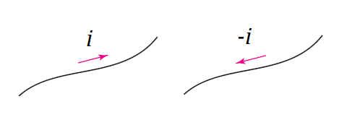
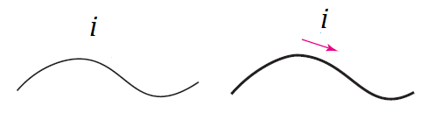
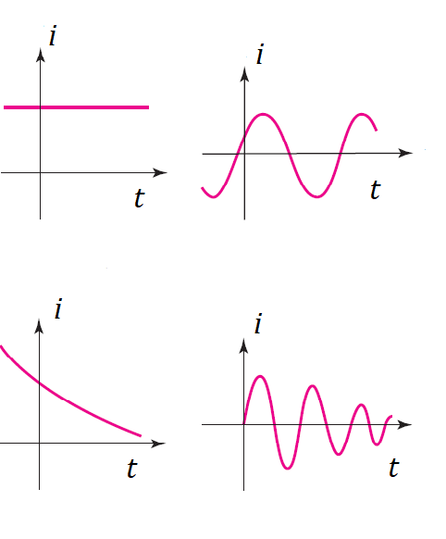
Current (Cont..)
Direction of current flow: Opposite to the direction of motion of electrons.
Fig. 1. (a) Incorrect representation.
(b) Correct representation.
Fig. 2. Both the above representations have exact meaning.
(a)
(b)
Fig. 3 Different types of current.
(c)
(d)

Slide 7

Voltage
Voltage can be defined as the energy required to move a unit charge through an element.
The same is also known as emf or potential difference.
Mathematically can be defined as:
$$v=\frac{dw}{dq}$$
$v$ is the voltage in volts (V), $w$ is the work in joules (J), and $q$ is the charge in C.

Slide 8
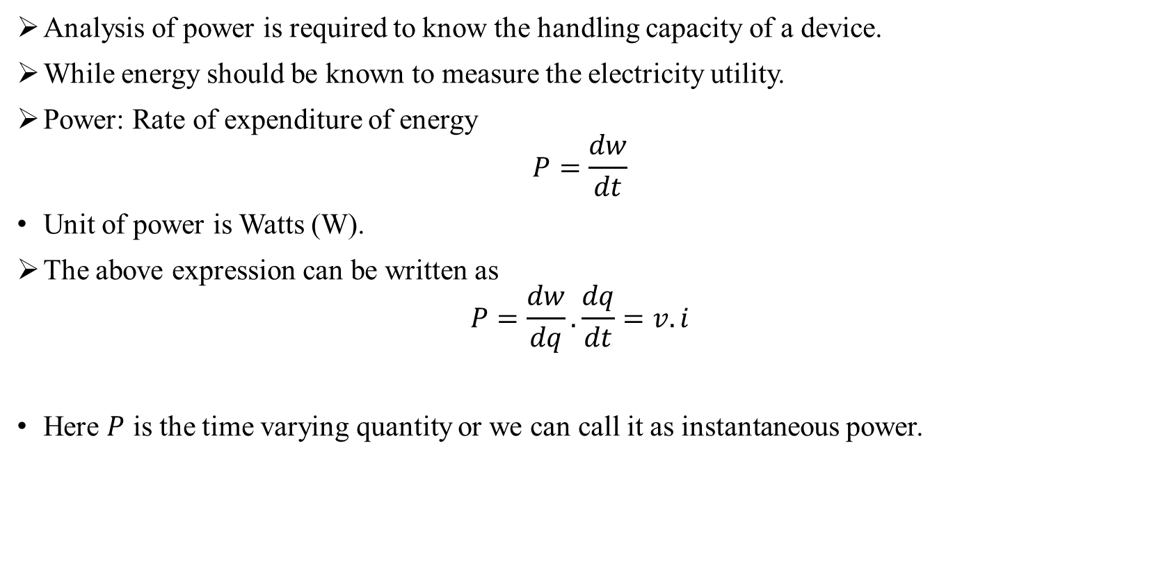
Power and Energy
Analysis of power is required to know the handling capacity of a device.
While energy should be known to measure the electricity utility.
Power: Rate of expenditure of energy
$$P=\frac{dw}{dt}$$
Unit of power is Watts (W).
The above expression can be written as
$$P=\frac{dw}{dq}.\frac{dq}{dt}=v.i$$
Here $P$ is the time varying quantity or we can call it as instantaneous power.

Slide 9
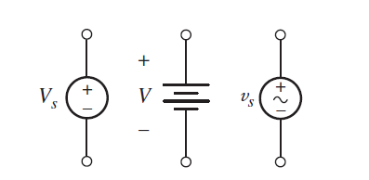
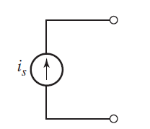
Voltage and Current Sources
Independent and dependent sources.
An independent voltage source is characterized by a terminal voltage which is completely independent of the current through it.
For an independent current source, the current through the element is completely independent of the voltage across it.

Slide 10
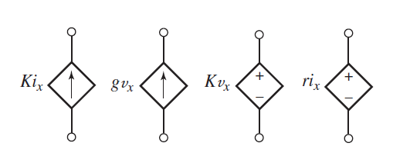
Voltage and Current Sources (Cont..)
In the dependent, or controlled, source, the source quantity is determined by a voltage or current existing at some other location in the system being analyzed.

Slide 11
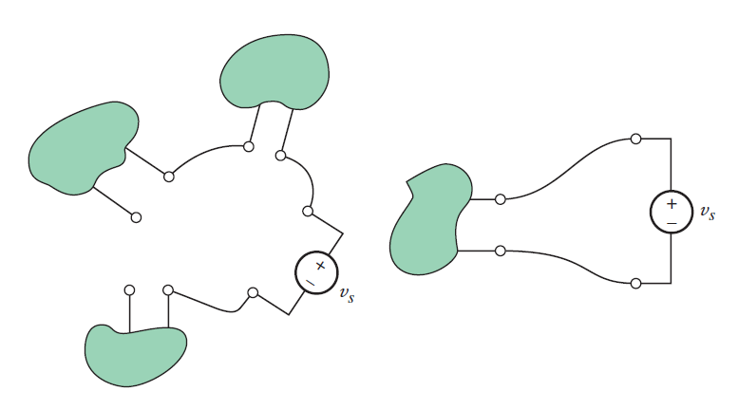
Networks and Circuits
Network: The interconnection of two or more simple circuit elements forms an electrical network.
Circuit: If a network contains at least one closed path, it is known an electric circuit.
Every circuit is a network, but not all networks are circuits
(a)
(b)

Slide 12
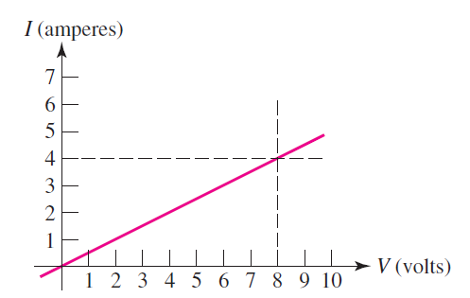

Ohm’s Law
Ohm’s law states that the voltage across conducting materials is directly proportional to the current flowing through the material.
Mathematically can be written as:
$$v=Ri$$
where the constant of proportionality is called the resistance.
The unit of resistance is the ohm, which is 1 V/A and abbreviated by a capital omega (Ω).

Slide 13
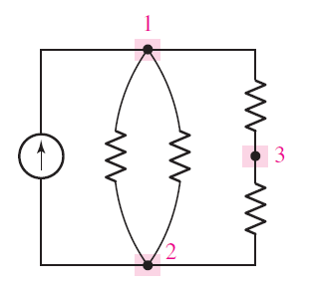
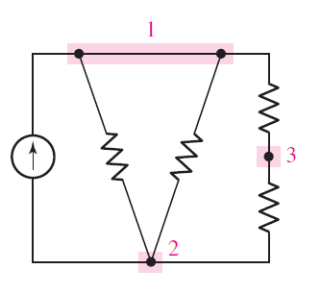
Nodes, Paths, Loops, and Branches
Node: A point at which two or more elements have a common connection is called a node.
Path: If no node was encountered more than once, then the set of nodes and elements that we have passed through is defined as a path.
Loop: If the node at which we started is the same as the node on which we ended, then the path is, by definition, a closed path or a loop.
Branch: Branch is a single path in a network, composed of one simple element and the node at each end of that element. Thus, a path is a particular collection of branches.
(a)
(b)

Slide 14
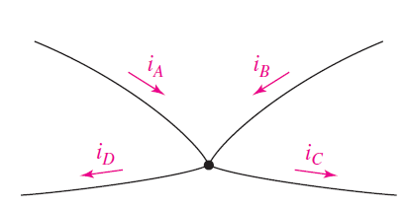

Kirchhoff’s Current Law (KCL)
The algebraic sum of the currents entering any node is zero.
This law represents a mathematical statement of the fact that charge cannot accumulate at a node.
A node is not a circuit element, and it certainly cannot store, destroy, or generate charge.
$$i_{A}+i_{B}−i_{C}+i_{D}=0$$

Slide 15
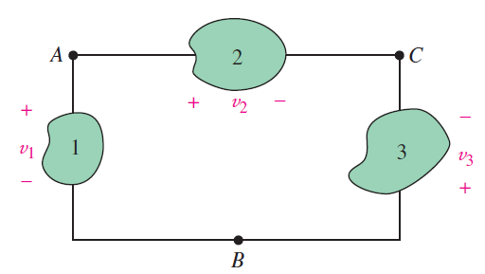

Kirchhoff’s Voltage Law (KVL)
The algebraic sum of the voltages around any closed path is zero.
$$\sum_{n=1}^{N}{v_{n}=0}$$
$$v_{1}+v_{2}+v_{3}+.. ..+v_{N}=0$$
$$v_{1}−v_{2}+v_{3}=0$$

Slide 16
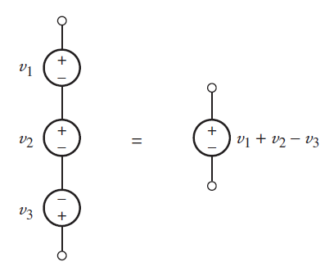
Series and Parallel Connected Sources
All of the elements in a circuit that carry the same current are said to be connected in series.
Elements in a circuit having a common voltage across them are said to be connected in parallel.
Several voltage sources in series may be replaced by an equivalent voltage source having a voltage equal to the algebraic sum of the individual sources.

Slide 17
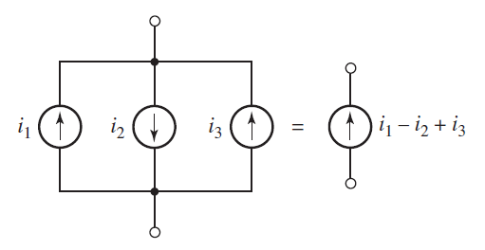
Series and Parallel Connected Sources (Cont..)
Parallel current sources may also be combined by algebraically adding the individual currents.

Slide 18
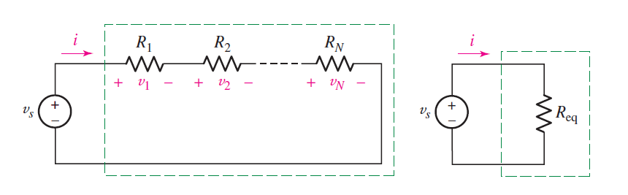

Resistors in Series
Applying KVL for the following circuit:
$$v_{s}−v_{1}−v_{2}−..−v_{N}=0$$
$$v_{s}−R_{1}i−R_{2}i−..−R_{N}i=0$$
$$v_{s}=\left(R_{1}+R_{2}+..+R_{N}\right)i$$
$$v_{s}=R_{eq}i$$

Slide 19
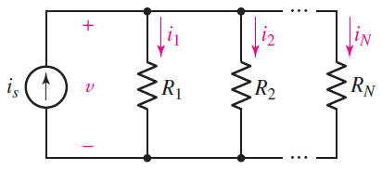
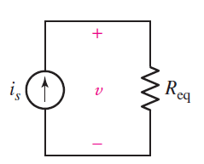

Resistors in Parallel
Applying KCL for the following circuit:
$$i_{s}−i_{1}−i_{2}−..−i_{N}=0$$
$$i_{s}−\frac{v}{R_{1}}−\frac{v}{R_{2}}−..−\frac{v}{R_{N}}=0$$
$$i_{s}=\frac{v}{R_{eq}}$$
$$\frac{1}{R_{eq}}=\frac{1}{R_{1}}+\frac{1}{R_{2}}+..+\frac{1}{R_{N}}$$

Slide 20
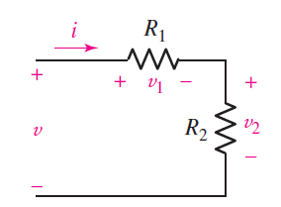

Voltage Division
$$v=v_{1}+v_{2}={(R}_{1}+R_{2})i$$
$$i=\frac{v}{R_{1}+R_{2}}$$
$$v_{1}=iR_{1}=\frac{R_{1}}{R_{1}+R_{2}}v$$
$$v_{2}=iR_{2}=\frac{R_{2}}{R_{1}+R_{2}}v$$

Slide 21
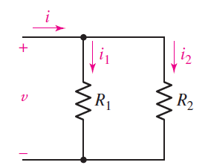

Current Division
$$i=i_{1}+i_{2}=\frac{v}{R_{1}}+\frac{v}{R_{2}}=v\left(\frac{1}{R_{1}}+\frac{1}{R_{2}}\right)$$
$$i_{2}=\frac{v}{R_{2}}=i\frac{\frac{1}{R_{2}}}{\frac{1}{R_{1}}+\frac{1}{R_{2}}}=i\frac{R_{1}}{R_{1}+R_{2}}$$
$$i_{k}=i\frac{\frac{1}{R_{k}}}{\frac{1}{R_{1}}+\frac{1}{R_{2}}+..+\frac{1}{R_{N}}}$$

Slide 22
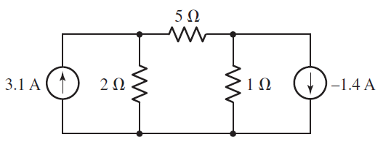
Nodal Analysis
N-node circuit will need (N − 1) voltages and (N − 1) equations. Each equation is a simple KCL equation.
Problem 1:

Slide 23
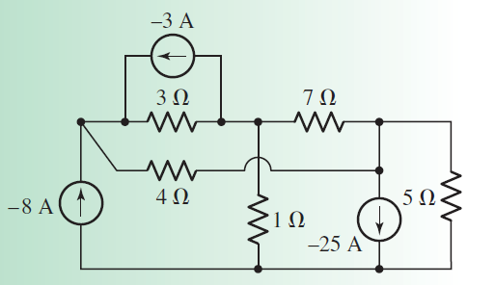
Nodal Analysis (Cont..)
Problem 2:

Slide 24
Summary (Nodal Analysis)
Count the number of nodes (N).
2. Designate a reference node.
3. Label the nodal voltages (there are N − 1 of them).
4. Write a KCL equation for each of the nonreference nodes.
5. Express any additional unknowns such as currents or voltages other than nodal voltages in terms of appropriate nodal voltages.
6. Organize the equations.
7. Solve the system of equations for the nodal voltages

Slide 25
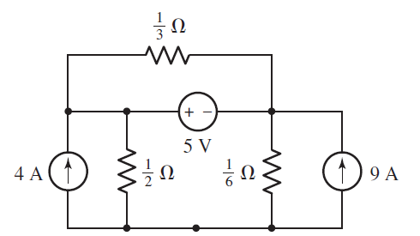
Supernode

